Slide 1



THEORY
Training Program 0:
AI Concepts
M00: AI Concepts

Slide 2
MODULE 00
AI Concepts

Slide 3
M00 AI CONCEPTS
Methodology
CBK: Common Body of Knowledge: structure AI theory to establish core doctrine and prevent tactical errors or redundant efforts.
Code AI systems to translate theoretical knowledge into operational proficiency through hands-on application.
Read research papers by identifying emerging technologies before they hit the mainstream.

Slide 4
M00 AI CONCEPTS
Reasoning
Large Language Models Are Zero-Shot Reasoners
Introduced Zero-Shot Chain-of-Thought (Zero-Shot-CoT) term
Open AI o1 System Card

Slide 5
M00 AI CONCEPTS
Tools
Anything LLM 1.91
Ollama + Page Assist
LM Studio 0.3.36
Text2Vec
Pip install open-webui; open-webui serve

Slide 6
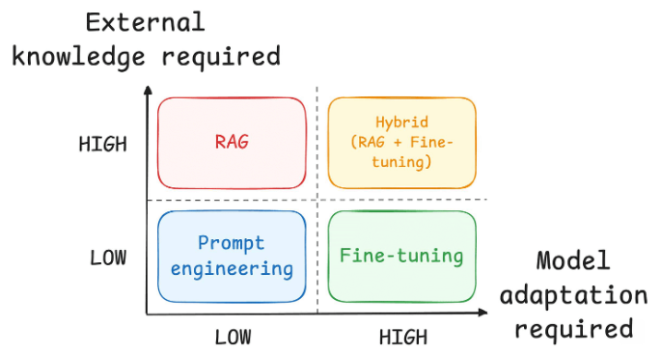
M00 AI CONCEPTS
Embedding

Slide 7
M00 AI CONCEPTS
Embedding
Layer 1 (Base Embedding): This is the foundational layer, trained on a massive corpus of text and code. It provides a general understanding of the data (a basic sense of what different words and concepts represent).
Layer 2 (Contextual Embedding): This layer uses a technique called “attention” to understand the context of the input text. It creates a more nuanced vector representation that considers the surrounding words and phrases. It’s like reading a sentence and understanding the nuances of each word.
Layer 3 (Semantic Embedding): This layer builds upon the contextual embedding, deepening the understanding of the meaning. It creates a vector that represents the core semantic meaning of the text or code.

